Slide 1

Semester Project
ADEYE Abiola & BRUNO Etienne
June 15, 2023

Slide 2
Research Question
In this project, we aim to understand the key factors that influence engagement rates of tweets from both American and French Politicians or Celebrities. More precisely, we want to understand how platform amplification affects impression counts.
Terminology:
Platform amplification : using a digital platform's algorithms or features to increase the reach or visibility of content. This can involve a variety of strategies, such as leveraging trending topics, using popular hashtags, optimizing posting times for maximum visibility.
Engagement : defined in our case as being the combination of likes, quotes, retweets, replies.
The Effect of Platform Amplification on Social Media Posts
Notes:
ABIOLA

Slide 3
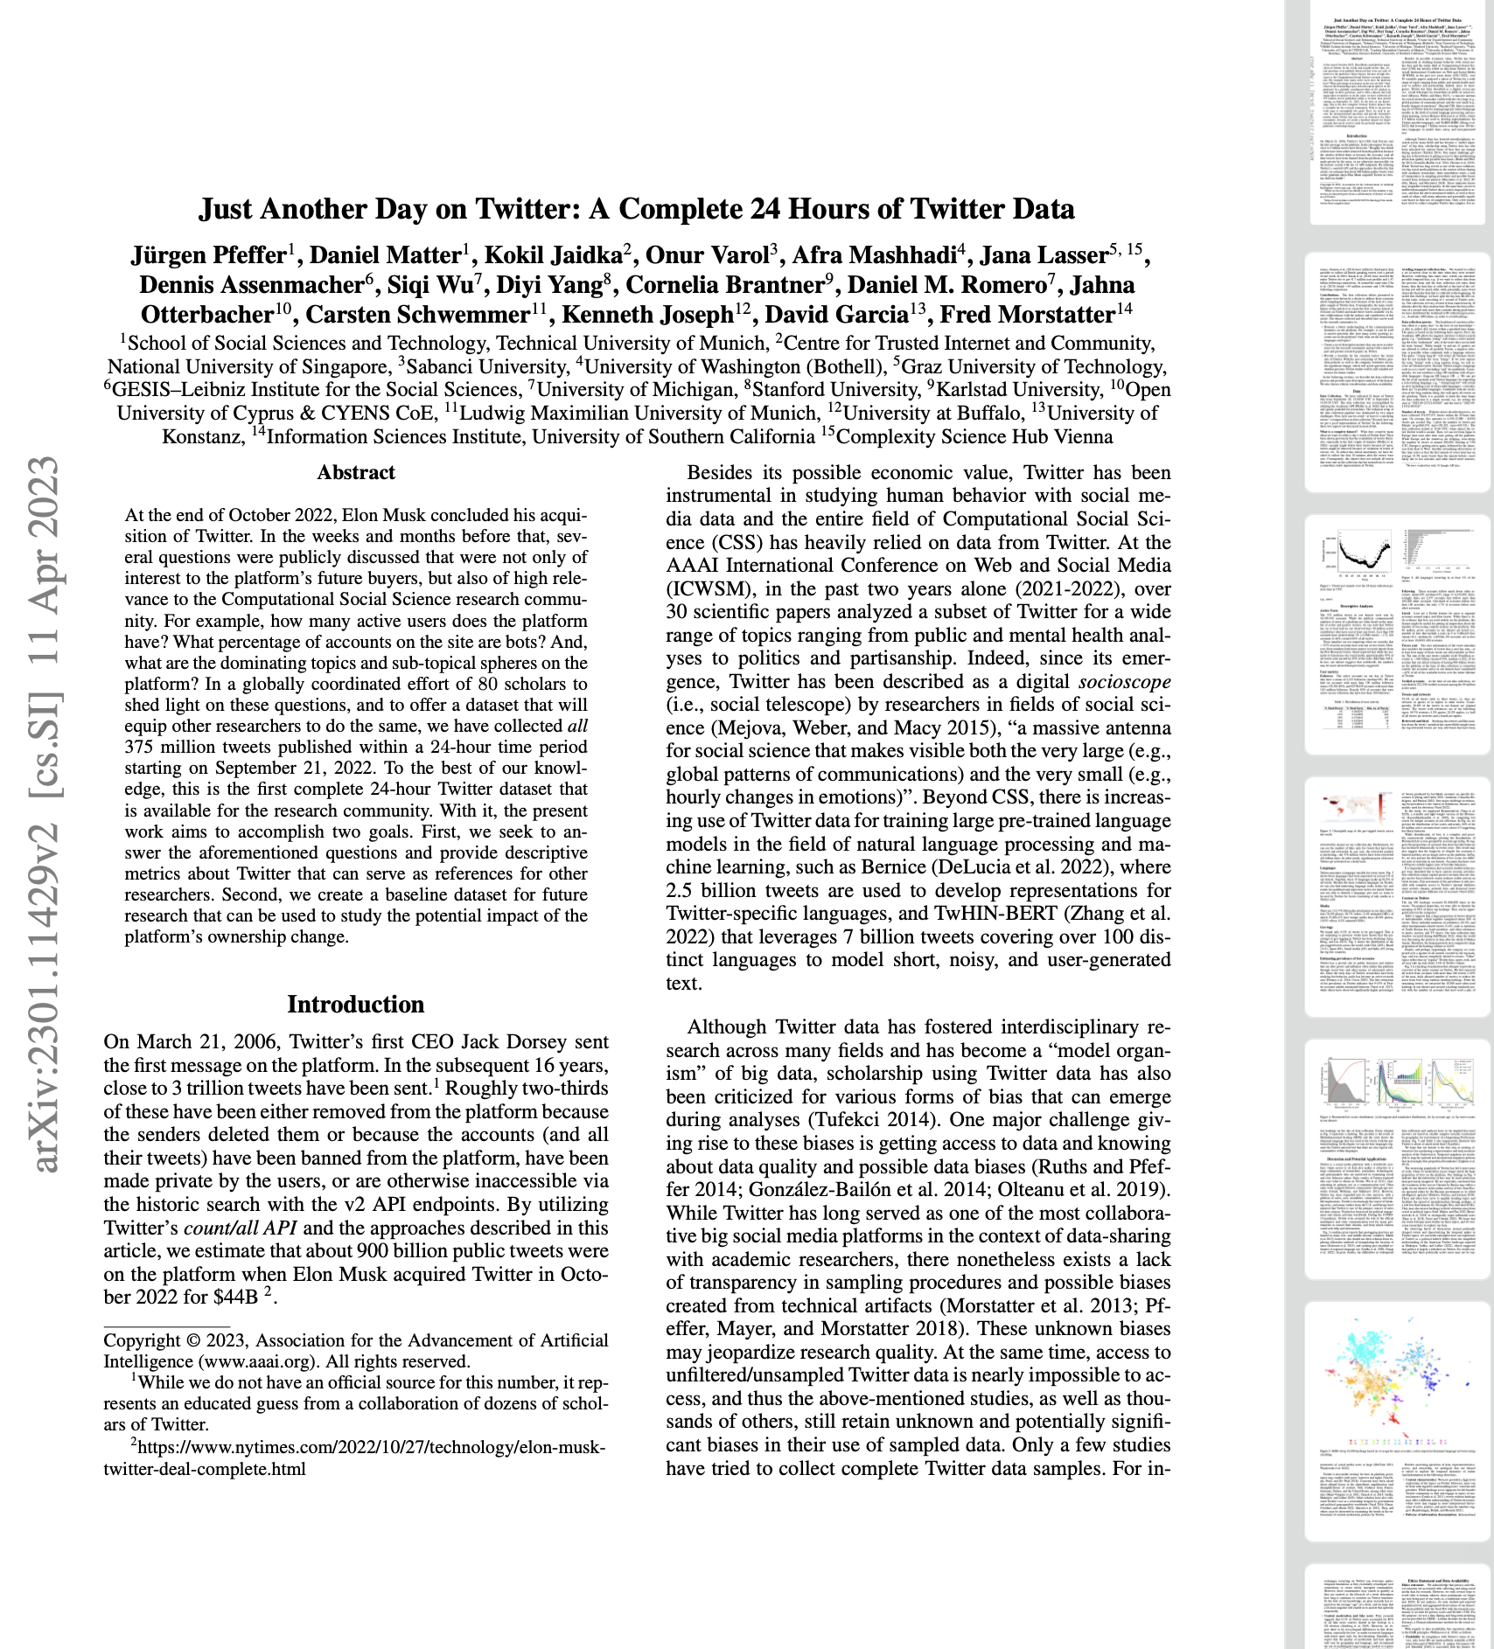
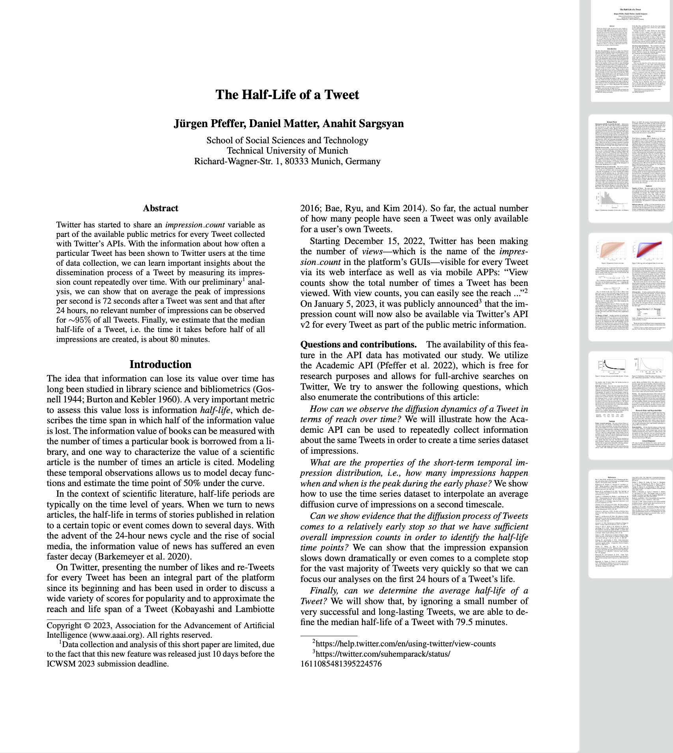
Related Work
The Half-Life of a Tweet:
Explores the lifespan and dissemination process of a tweet through impression count tracking.
Defines notions of:
“Impression Count”,
“Half-Life of a Tweet” (80 minutes)
“Peak of Impressions” (72 seconds)
After 24 hours, about 95% of tweets do not receive significant impressions, indicating rapid decrease in tweet relevance post-publishing.
Notes:
ETIENNE

Slide 4
Related Work
Just Another Day on Twitter:
Explores user demographics, language use, media attachments, geo-tagging, and the prevalence of bot accounts.
Average of 2,123 followers for active accounts, six accounts with over 100 million followers, and 401 billion retweets from the 374 million tweets collected.
15 languages make up 92.5% of all tweets.
30% of all tweets refer to entertainment
79.2% of tweets are engagements with other tweets (retweets, quotes, replies), with 20.8% being original content.
Metrics used to measure engagement include follower counts, number of retweets, bot scores, language used, and content categories.
Notes:
ETIENNE

Slide 5
Data Acquisition And Exploration
The Effect of Platform Amplification on Social Media Posts
Primary objective: develop a predictive model to estimate engagement levels based on certain features.
Features are chosen for their potential impact on a tweet's visibility and engagement.
Data Acquisition:
Scraped data for our different engagement groups:
American celebrities + politicians
French celebrities + politicians
Data from the public twitter API
Very rich data-sets. Impossible to process in a single-threaded way
Used Spark to extract meaningful data and to refine datasets (more on this later)
Notes:
ABIOLA

Slide 6
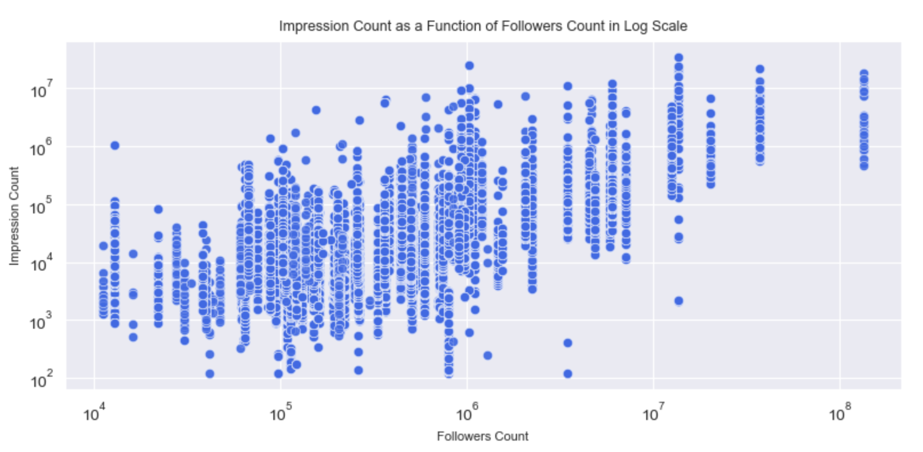
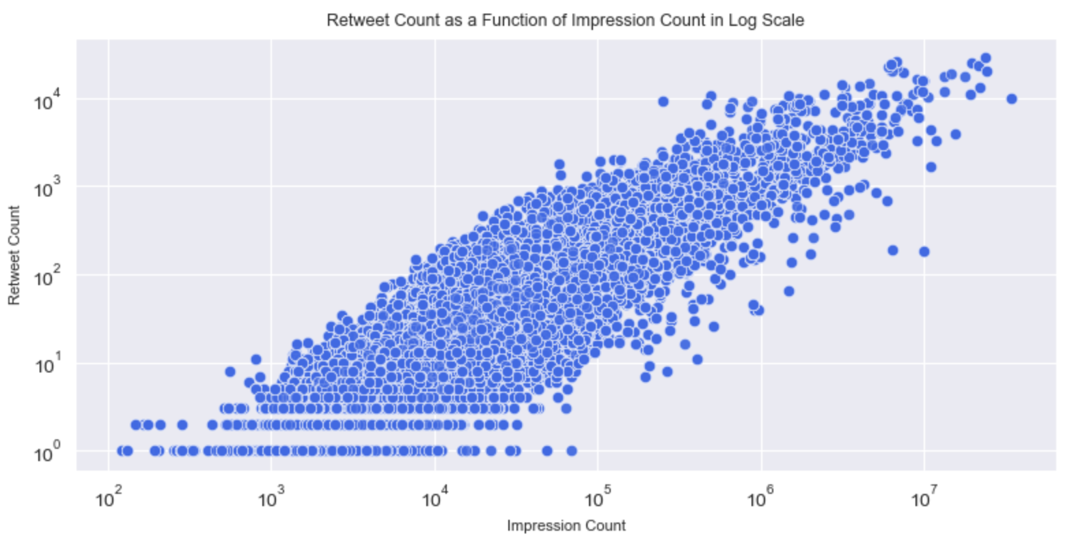
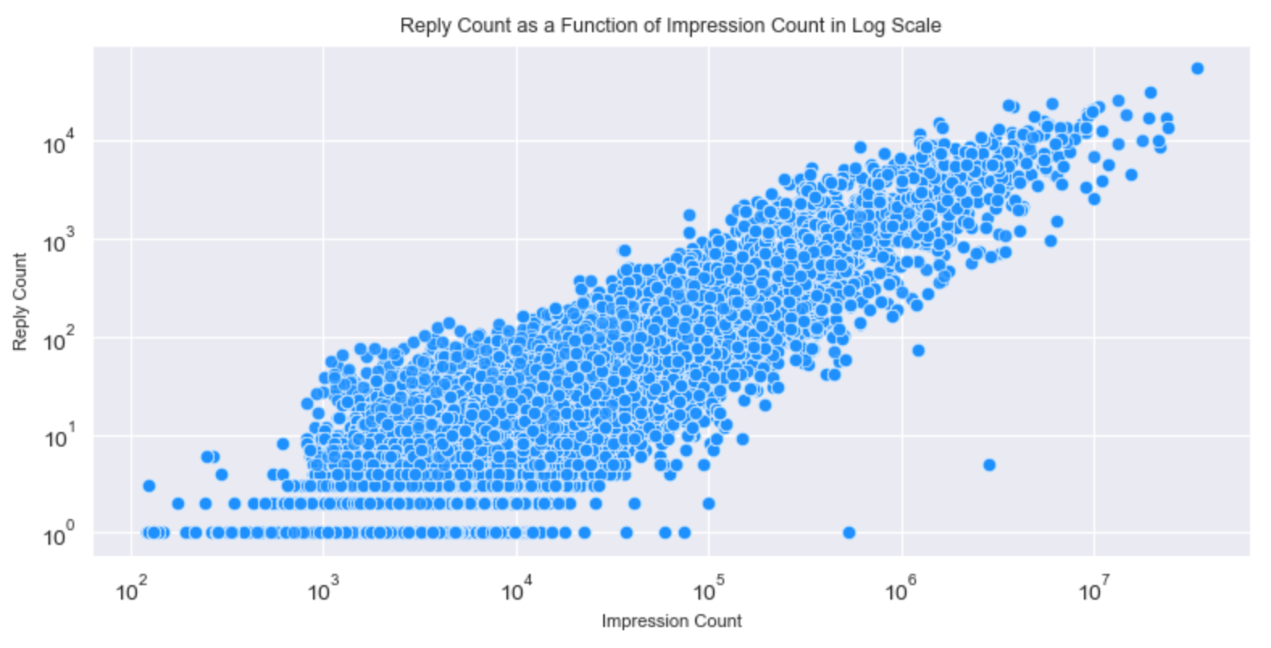
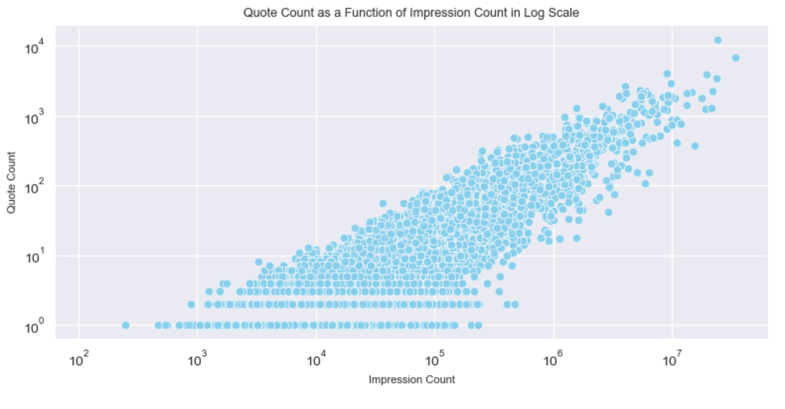
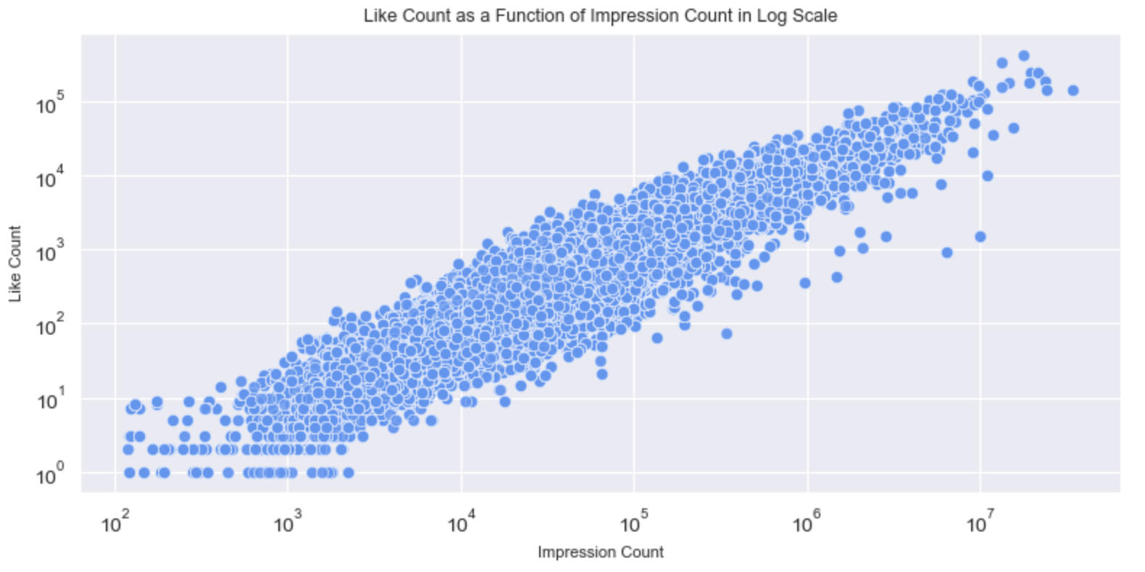
Data Acquisition And Exploration
The Effect of Platform Amplification on Social Media Posts
Two types of plots generated to visualize relationship between variables:
Impressions as a function of followers: shows relationship between number of followers and number of impressions,
Engagement as a function of impression count: Illustrates relationship between number of impressions and level of engagement
Motivation: Visually understand clear trends or relationships between variables
Notes:
ETIENNE

Slide 7
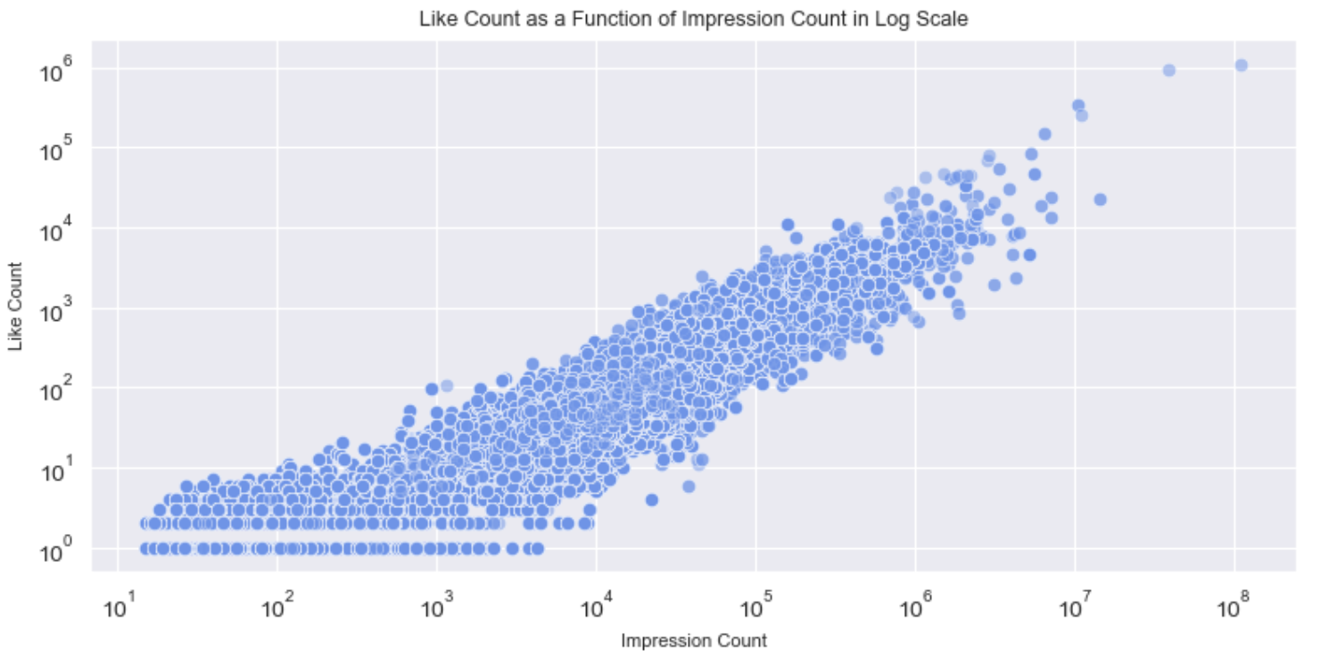
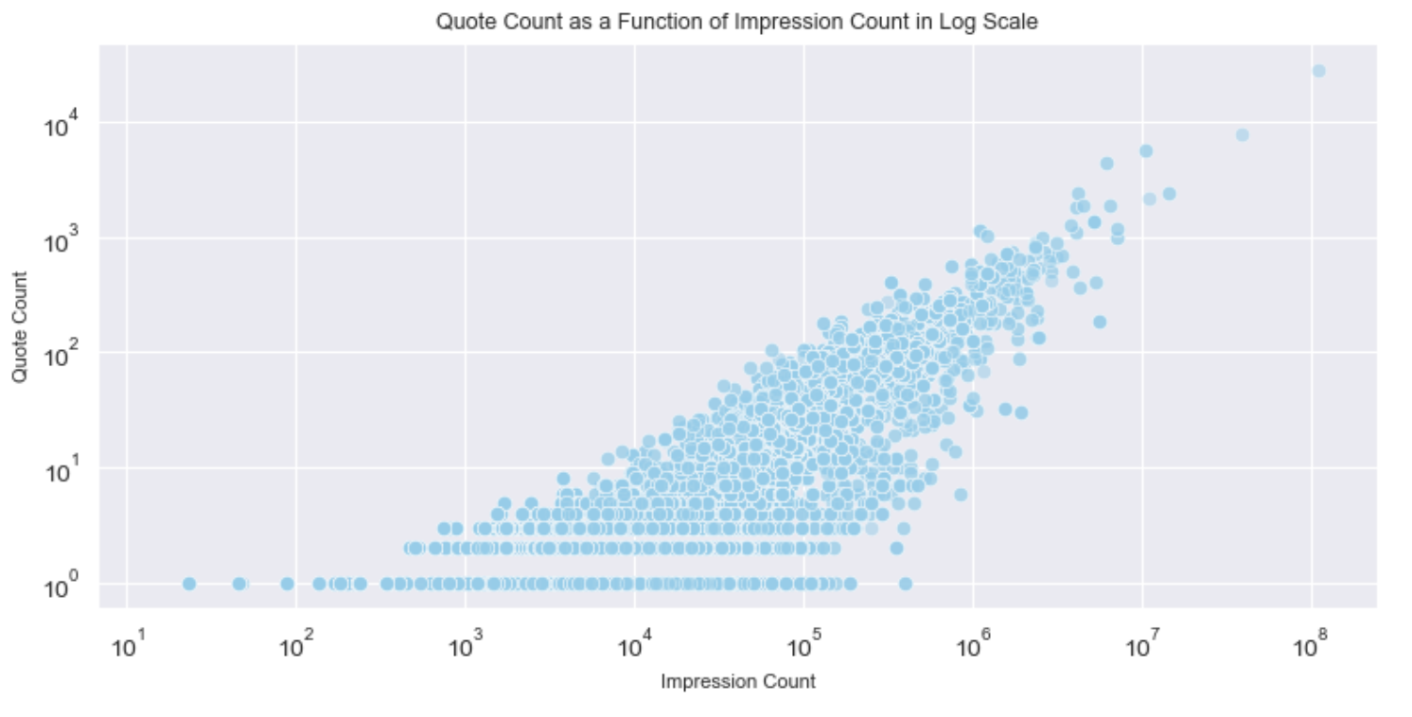
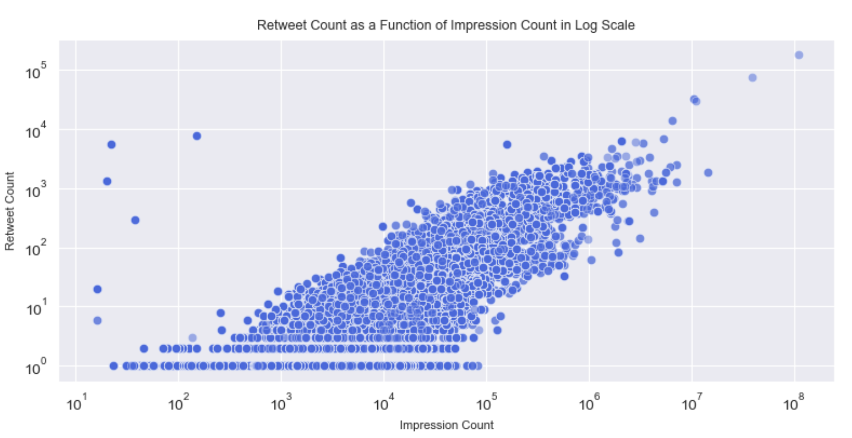
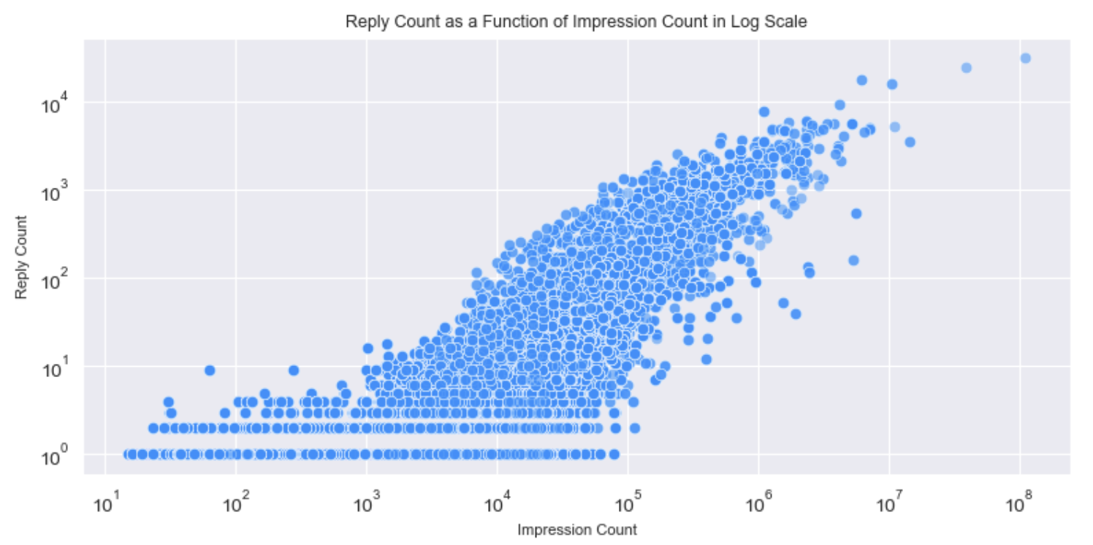
Data Acquisition And Exploration
The Effect of Platform Amplification on Social Media Posts
Logarithmic relation between impression count and the engagement parameters (multiplicative effect):
Let E be the engagement metric and I the impression count. We have the following relation : log(E) ∝ log(I))
Percentage change in impressions (I) will result in a percentage change in engagement (E).
E = I^k where k is the elasticity
Notes:
ETIENNE

Slide 8
Data Processing
The Effect of Platform Amplification on Social Media Posts
Feature Extraction:
Key data components from each tweet are extracted, including the tweet text, like count, media items, followers count, and context annotations.
Categorizing context annotations linked to each tweet with Zero Shot Learning:
Tweets are assigned to pre-existing clusters of annotations for thematic grouping.
For tweets without matching context annotations, zero-shot classification is used.
Zero-shot learning is used to assign context annotations to 'anomalous' tweets based on semantic similarity to existing clusters.
This ensures that no data is left ungrouped, even when there's no direct match in context annotations.
Text Analysis:
Feature generation is the next phase. Additional features derived from tweet text and metadata are produced.
Generated features include sentiment score, tweet length, and posting hour.
At the end of this process, all extracted and generated features are consolidated in a final data frame.
Notes:
ABIOLA

Slide 9
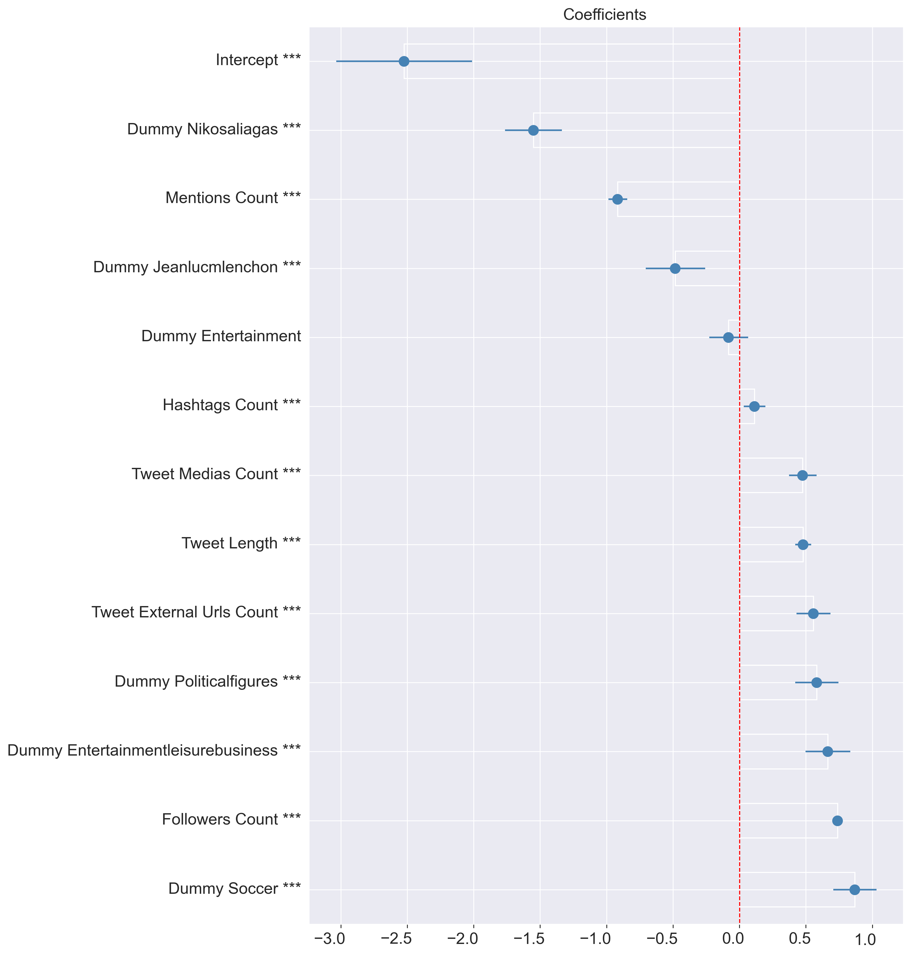
Regression Analysis
The Effect of Platform Amplification on Social Media Posts
Context annotations are transformed into a binary format through one-hot encoding, allowing each unique context annotation to be treated as a distinct, independent feature.
For each dataset, we have some common statistically significant independent variables that partially explain resulting the impression count.
Global Variables :
Followers Count
Hashtags Count
Presence of media
Length of the tweet
Number of external URLs
Tweet sentiment (US only)
Specific to a dataset :
Tweet most frequent context annotations.
Notes:
Initial results obtained with regression on the raw cleaned dataset were not efficient, as indicated by a low R2 value, high BIC and AIC values, and a significant number of features that were not statistically significant at the 5% level.
To improve this, several strategies were employed:
Dataset Filtering: The team filtered the dataset to eliminate tweets with an impression count below 100, considering them as outliers.
Log Transformation: All variables were logarithmically transformed. This decision was based on initial data exploration that showed a more coherent relationship between impression count and engagement metrics when both were presented on a log scale.
Feature Selection: In the final regression model, only statistically significant variables were retained.
The log transformation was beneficial for several reasons: it reduced skewness, scaled down large values, and linearized relationships between variables. These transformations improved the performance and interpretability of the regression model.
The new model showed improved performance, with R2 values close to 0.6 for each dataset, indicating a good fit. Upon examining the coefficients, a number of insights were derived. The number of followers and the incorporation of media in tweets had positive coefficients, indicating a strong association with an increase in impressions. On the other hand, the use of mentions was negatively correlated with impression count.
Finally, the text emphasizes the importance of careful interpretation of the coefficients, especially given the log-log scale. The coefficients should be understood in terms of elasticity, indicating a percentage change in the dependent variable for a given percentage change in the independent variable.

Slide 10
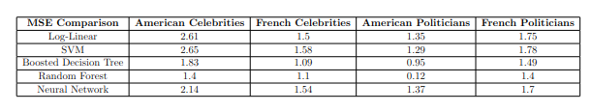
Other Models
The Effect of Platform Amplification on Social Media Posts
Random Forest Regression:
Idea: Uses multiple decision trees to average predictions.
Motivation: Mitigates overfitting and handles outliers well.
Results: Best performer. Lowest MSE for American Politicians (0.12)
Boosted Decision Tree Regression:
Idea: Sequentially builds decision trees, correcting predecessor errors.
Motivation: Deals effectively with complex variable interactions.
Results: Good performance. Lowest MSE for French Celebrities (1.09).
SVM Regression:
Idea: Non-parametric method leveraging structural risk minimization.
Motivation: Handles high dimensional spaces and non-linear relationships.
Results: Decent but not best. MSE for American Celebrities is 2.65.
Neural Network Regression:
Idea: Uses layered artificial neurons to minimize prediction error.
Motivation: Models complex, non-linear relationships and learns from large data volumes.
Results: Decent but not best. MSE for American Celebrities is 2.14.
Notes:
ABIOLA

Slide 11
Results
The Effect of Platform Amplification on Social Media Posts
We were able to find some key features that have high impact on each dataset such as:
Followers Count
Hashtags Count
Presence of media
Length of the tweet
Number of external URLs
(Log)-Linear Regression can yield accurate and interpretable results.
More sophisticated models often achieve superior performance, (lower MSE) although these results may be more complex to interpret.

